Slide 1


THE SECRET LIFE OF NEGATIVE RESULTS
Samira Khan

Slide 2

THE SECRET LIFE OF NEGATIVE RESULTS
Your negative results are secretly saving the world!!!
Notes:
Today I will talk about the secret life of negative results. We all have been there – being excited about some idea or direction and after putting a lot of work realizing that it does not work. Today I will show that negative results are actually not the end of the world, on the contrary, they might be secretly saving the world!

Slide 3

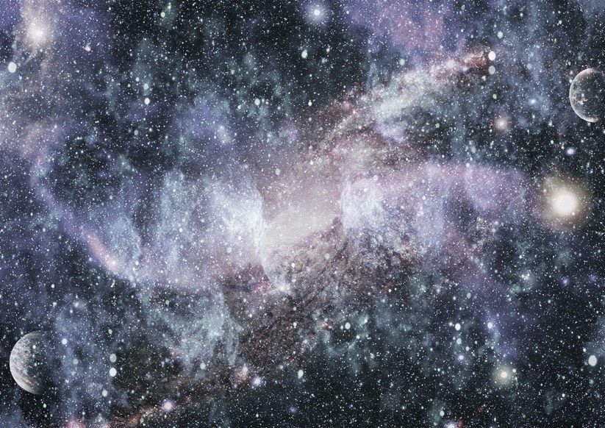
THE SECRET LIFE OF NEGATIVE RESULTS
SCIENTIFIC REVOLUTION
Negative results initiate scientific revolutions!!!
Notes:
If we look at the history of science in a longer period of time, say hundreds of years, we will see that negative results are essential for scientific revolution! Actually, the pre-condition of a scientific revolution is negative results.

Slide 4



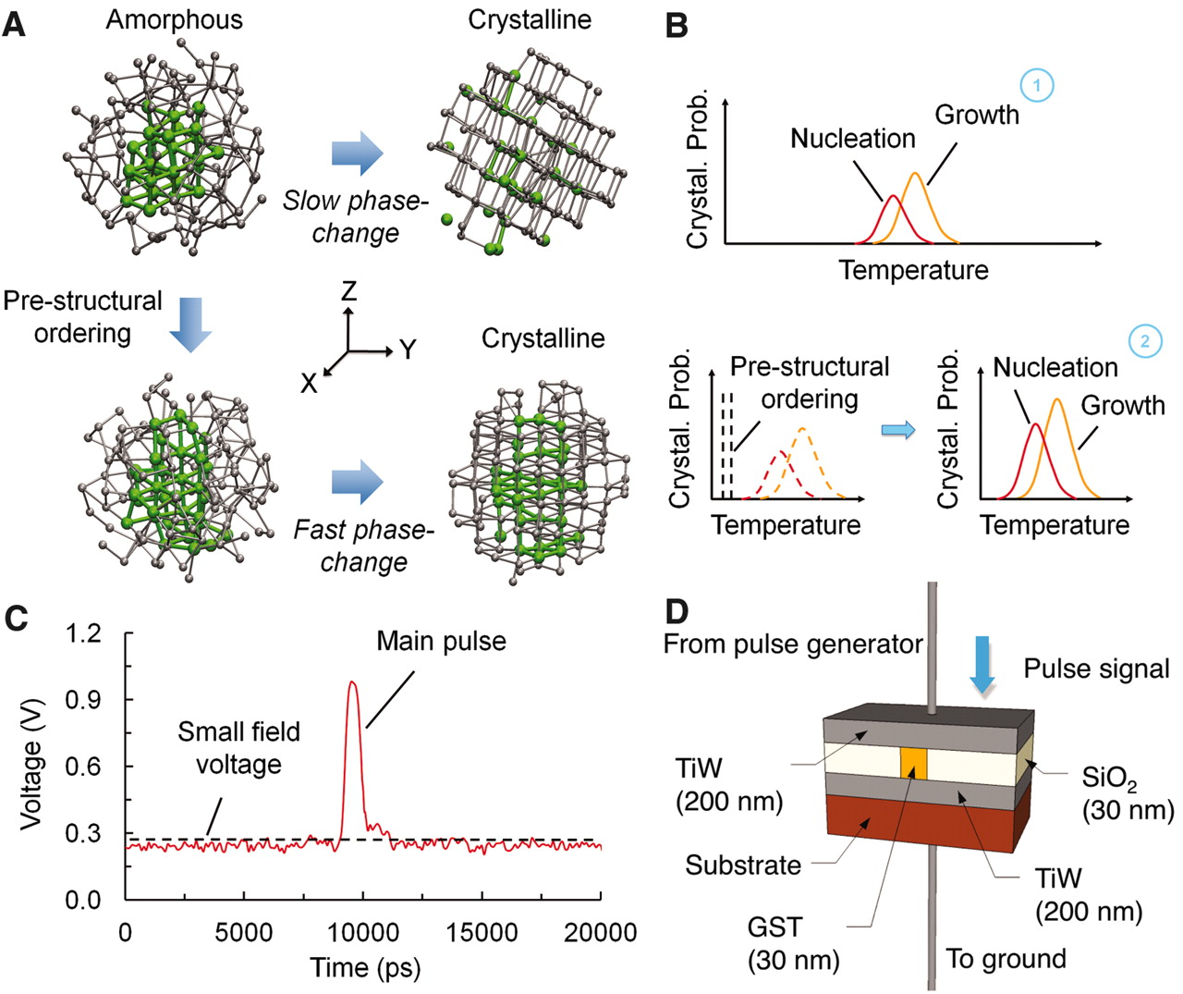
THE SECRET LIFE OF NEGATIVE RESULTS
NEW TECHNOLOGIES
MEMORY
DRAM SCALING IS ENDING
SCIENTIFIC REVOLUTION
CORES & MEMORY
Negative Results
In Scientific Revolution
My Experience with
Negative Results
CURRENT TIME
Close to a Scientific Revolution
CONCLUSION
Notes:
Here is the agenda for today. First, I will talk about the impact of the negative results in the history of science. Then I will jump to more low-level and talk about my experience of negative results. Then, I will move to higher picture again and talk about the current state of computer technology and how we are close to a new revolution!

Slide 5
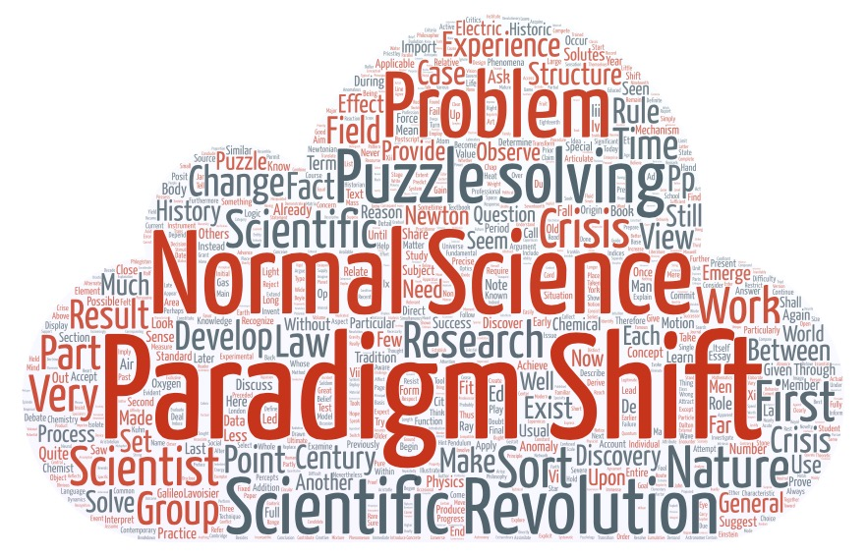
THE STRUCTURE OF SCIENTIFIC REVOLUTIONS
Changed “the image of science by which we are now possessed”
Notes:
Let’s let’s take a look at how negative results initiate a revolution. By the way, this is not a random theory that I am proposing. It is based on this famous book by Thomas Kuhn which literally made popular the concept of paradigm shift and scientific revolution – concepts that we use in our day to day life all the time.

Slide 6


THE STRUCTURE OF SCIENTIFIC REVOLUTIONS
Not only there is revolution in science, there is a structure of the revolutions
Copernicus’s Revolution or Newton’s Principia
Used the word “Paradigm Shift” to indicate revolution
Two properties define a paradigm shift
"sufficiently unprecedented to attract an enduring group of adherents away from competing modes of scientific activity,"
Paradigm Shift
Old Model
New Model
Notes:
So the title of Kuhn’s book is the structure of scientific revolution. Not only there is a revolution in science, there is also a structure to it. And by revolution he means things that literally changes the world such as Copernicus’s revolution or newton’s principia
There are two properties that define a revolution
First, the paradigm shift attracts sufficiently large number of people from the old model who believes in the new model

Slide 7

THE STRUCTURE OF SCIENTIFIC REVOLUTIONS
Not only there is revolution in science, there is a structure of the revolutions
Copernicus’s Revolution or Newton’s Principia
Used the word “Paradigm Shift” to indicate revolution
Two properties define a paradigm shift
"sufficiently unprecedented to attract an enduring group of adherents away from competing modes of scientific activity,"
"sufficiently open-ended to leave all sorts of problems for the redefined group of practitioners to resolve.”
Notes:
And Second, the new model is sufficiently open ended so that this group of people have many problems to solve

Slide 8
THE STRUCTURE OF SCIENTIFIC REVOLUTIONS
Pre-paradigm
0
Scientific Revolution
4
Normal Science
1
Crisis and
Emergence of Scientific Theory
3
Anomaly
2
History of Science
Notes:
Here is the structure of scientific revolution proposed by Kuhn. there is one [re-stage called pre-paradigm stage and There are main four stages that occur in a cycle.

Slide 9

PRE-PARADIGM
No accepted scientific facts and rules
Exists many competing school of thoughts
Example: History of physical optics
Particles emanating from bodies,
modification of medium
Pre-paradigm
Eighteenth century:
Material corpuscles
Nineteenth century:
Wave
Current Status:
Wave + particle
Ends with triumph of one pre-paradigm school and
emergence of a paradigm
Notes:
So what’s happen in the pre-paradigm stage. There is no accepted scientific norms or rules. And there exists many competing school of thoughts.
For example, let’s take the history of physical optics. The current status is light is both wave and particle, but at 19t h century, we thought it wave, and in 18th century we though it was a particle. Each of these timeline presents a paradigm shift, but in the pre-paradigm stage, there were these weird theories that light is particle emanating from bodies, generated from modification of medium, etc, etc.
The pre-paradigm ends with the triumph of one theory.

Slide 10
THE STRUCTURE OF SCIENTIFIC REVOLUTIONS
Pre-paradigm
0
Scientific Revolution
4
Normal Science
1
Crisis and
Emergence of Scientific Theory
3
Anomaly
2
History of Science
Notes:
Next is normal science stage

Slide 11
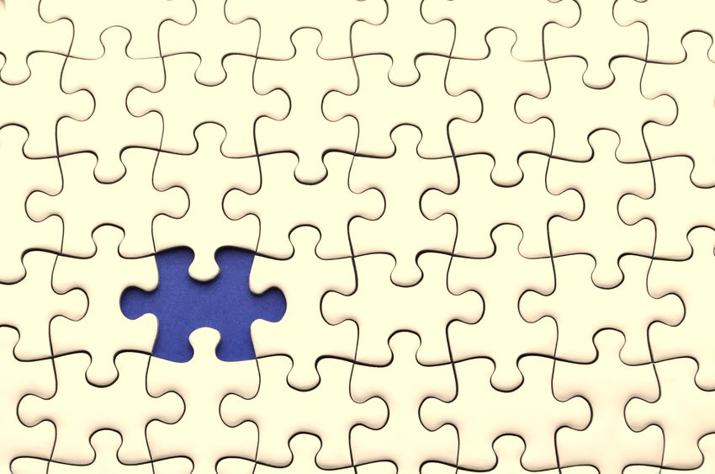


NORMAL SCIENCE
Established set of rules defines the field
Three characteristics
Focuses on
Details
“Puzzle-solving”
Cumulative
Normal Science does not aim at significant novelty
Notes:
During the normal science phase, there is an established set of rules that defines the field
There are three characteristics in this phase
Given the basic rules, scientists focus on details
“Puzzle solving”
It is more like puzzle solving that people focus on the articulation and proof of the theory
Normal science is cumulative, adds to scope and precision of scientific knowledge
As you can see normal science does not aim at significant novelty

Slide 12
THE STRUCTURE OF SCIENTIFIC REVOLUTIONS
Pre-paradigm
0
Scientific Revolution
4
Normal Science
1
Crisis and
Emergence of Scientific Theory
3
Anomaly
2
History of Science
Notes:
That leads to our next stage anomaly

Slide 13
ANOMALY
Discoveries are rare in normal science
Expectations obscure the vision
But occasionally anomalies occur
Paradigm theory cannot explain the facts/experiments
Ptolemy’s Earth Centered Model
Copernicus’s Sun Centered Model
Astronomers were "so inconsistent in these [astronomical] investigations ... that they cannot even explain or observe the constant length of the seasonal year.”
Anomalies are precondition for discovery
Notes:
Discoveries are rare in the normal science, as people are trying to solve the puzzle based on the established rules. But occasionally anomalies occur where paradigm theory cannot explain the facts/experiments. For example, if we take ptolemy’s earth centered model, the astronomers were not even to explain the constant length of seasonal year. Copernicus saw it as an anomaly where others just ignore it!

Slide 14
THE STRUCTURE OF SCIENTIFIC REVOLUTIONS
Pre-paradigm
0
Scientific Revolution
4
Normal Science
1
Crisis and
Emergence of Scientific Theory
3
Anomaly
2
History of Science

Slide 15




CRISIS AND SCIENTIFIC REVOLUTION
Only anomaly is not enough for the emergence of new scientific theory
A crisis involves a period of extra-ordinary research
Many competing
models
Willingness to try anything
Debate over fundamentals
One paradigm gets accepted by all
Food for thought: Why do we have so many competing memory technologies now? Why so many computing models?

Slide 16
THE STRUCTURE OF SCIENTIFIC REVOLUTIONS
Pre-paradigm
0
Scientific Revolution
4
Normal Science
1
Negative Results
Crisis and
Emergence of Scientific Theory
3
Anomaly
2
History of Science

Slide 17
THE SECRET LIFE OF NEGATIVE RESULTS
NEW TECHNOLOGIES
MEMORY
DRAM SCALING IS ENDING
SCIENTIFIC REVOLUTION
CORES & MEMORY
Negative Results
In Scientific Revolution
Can we make DRAM Scalable?
CURRENT TIME
Close to a Scientific Revolution
CONCLUSION

Slide 18
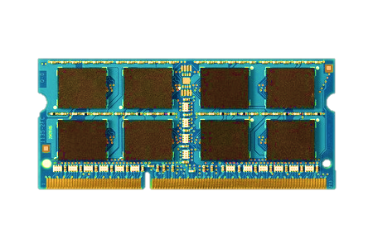
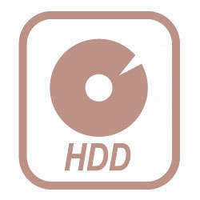
MEMORY IN TODAY’S SYSTEM
Processor
DRAM
Memory
Storage
DRAM is critical for performance
Notes:
First I will start with a high-level view of our systems. In today’s systems persistent data is stored in disk, and processor computes over that data. However, disk is very slow, In between processor and storage, we have faster main memory built with DRAM, so that the processor can compute over the data faster. So DRAM is very critical for performance.

Slide 19
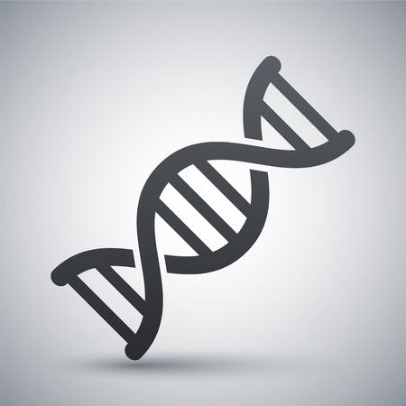




TREND: DATA-INTENSIVE APPLICATIONS
DNA/PROTEIN
SYNTHESIS
IMAGE
ANALYSIS
VIRTUAL
REALITY
IN-MEMORY FRAMEWORKS
Increasing demand for high-capacity,
high-performance, energy-efficient main memory
Notes:
However, DRAM is even more critical nowadays due to the emergence of data-intensive applications. We have scientific applications such a DNA or protein analysis that operate on huge data sets, and we have streams of data to process and analyze for images or virtual reality.
The current analytics frameworks store the whole working set in memory to reduce the over head of disk access.

Slide 20
DRAM SCALING TREND
2X/1.5 YEARS
2X/3 YEARS
DRAM scaling is getting difficult
Source: Flash Memory Summit 2013, Memcon 2014
Notes:
Here I show the trend of DRAM chip capacity over the years. In the x axis I show the year of mass production and in the y axis we have the capacity in megabits per chip. So in the last 30 years, chip capacity grown from 1 Mb to 8Gb. However, if we look at the growth, previously capacity used to double every two year, but the scaling trend has slowed down and capacity is doubling in every three years. It is very clear from the trend that DRAM scaling is getting difficult.

Slide 21

DRAM SCALING CHALLENGE
WHY?
Technology
Scaling
DRAM Cells
DRAM Cells
Manufacturing reliable cells at low cost
is getting difficult
Notes:
This is due to the fact that, as the cells are shrinking down there are more failures in DRAM cells and Manufacturing reliable cells at low cost in getting difficult.

Slide 22
In order to answer this we need to take a closer look to a DRAM cell
WHY IS IT DIFFICULT TO SCALE?
DRAM Cells

Slide 23
A DRAM cell
DRAM CELL OPERATION
1. A DRAM cell stores data as charge
2. A DRAM cell is refreshed every 64 ms
Transistor
Capacitor
Bitline
Bitline
Contact
Capacitor
Transistor
LOGICAL VIEW
VERTICAL CROSS SECTION
Notes:
Here in the left side I will show a logical view of a DRAM cell, and in the right side I will show a vertical cross section of a cell. DRAM cell stores data as charge in a capacitor. The amount of the charge indicates either data zero or one. A transistor acts as a switch to the capacitor connected to a line called bitline. When a DRAM cell is read, the transistor in turned on, and the capacitor charge is sensed through the bitline.

Slide 24

DRAM RETENTION FAILURE
Retention time: The time when we can still access a cell reliably
Cells need to be refreshed before that to avoid failure
Retention Time
Retention Time
Refresh Interval
64 ms
Time
Capacitor
Retention time is
greater than refresh interval
Retention time is
less than refresh interval
Failure depends on the amount of charge

Slide 25
SCALING CHALLENGE: CELL-TO-CELL INTERFERENCE
Cell-to-cell interference affects the charge in neighboring cells
Technology
Scaling
Less Interference
More Interference
Indirect path
Indirect path
More interference results in more failures
Notes:
The second scaling challenge is cell-to-cell interference. Charge in DRAM cells can get affected by neighboring cells due to cell coupling. DRAM faced this interference from the manufacturing of the first DRAM chip. But as the cells are getting smaller there are more interference. The reason is interference provide an indirect path to neighboring cells. As the cells get smaller, it becomes easier to interfere the charge in other cells, resulting in DRAM failures.

Slide 26
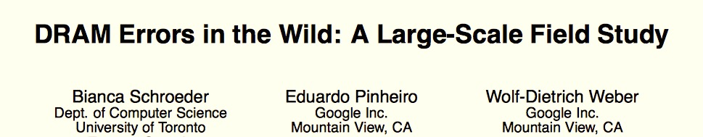
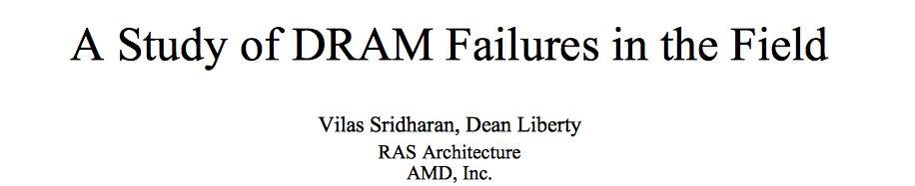
IMPLICATION: DRAM ERRORS IN THE FIELD
1.52% of DRAM modules failed in Google Servers
1.6% of DRAM modules failed in LANL
1.8X more failures in new generation DRAMs in Facebook
SIGMETRICS’09, SC’12, DSN’15
Notes:
DRAM comes with a 10 year reliability guarantee. However, as DRAM gets more vulnerable to failures with technology scaling, DRAM errors occurring in the field. Recent studies have shown that the fraction of the DRAM modules that fail in the field is higher than expected. 1.52% modules failed in Google and 1.6% in LANL. Los alamos national lab

Slide 27
GOAL
Enable
high-capacity, low-latency memory
without
sacrificing reliability

Slide 28
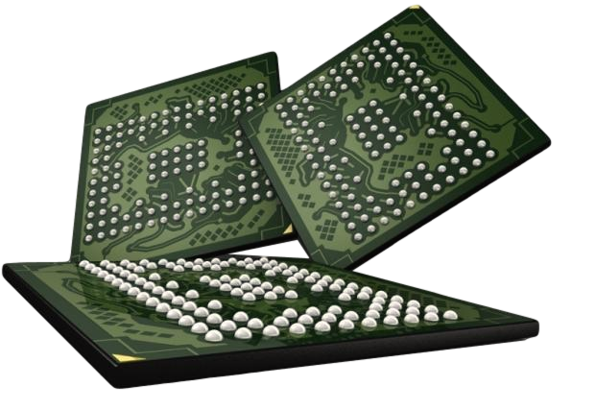
TRADITIONAL APPROACH TO ENABLE DRAM SCALING
Manufacturing Time Testing
PASS
FAIL
1. Manufacturers perform exhaustive testing of DRAM chips
2. Chips failing the tests are discarded

Slide 29


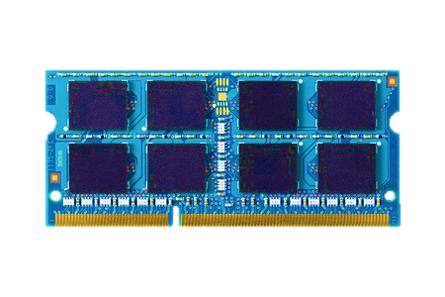
TRADITIONAL APPROACH TO ENABLE DRAM SCALING
Make
DRAM
Reliable
Unreliable
DRAM Cells
Reliable
DRAM Cells
Reliable System
Manufacturing Time
System
in the Field
DRAM has strict reliability guarantee
Notes:
Traditional way to enable scaling is to use circuit-level optimizations and testing to make sure every DRAM cell operates correctly. So when the chips are used in our systems, systems assumes that DRAM is error-free. Currently, Manufacturers have to provide a strict reliability guarantee for DRAMs.

Slide 30
MY APPROACH
Make
DRAM
Reliable
Unreliable
DRAM Cells
Reliable
DRAM Cells
Reliable System
Manufacturing Time
Manufacturing Time
System
in the Field
System
in the Field
Shift the responsibility to systems
Notes:
In my work, I show that in stead of the manufacturers, if the system becomes responsible for ensuring the reliability of the DRAM cells, manufactures can shrink the cells to smaller technology nodes without paying the cost for providing reliability guarantee. By shifting the responsibility of providing relizable DRAM operation from manufactures to systems, we can enable DRAM scaling.

Slide 31
VISION: SYSTEM-LEVEL DETECTION AND MITIGATION
Not fully tested during
manufacture-time
Ship modules
with possible failures
2
1
PASS
FAIL
Detect and mitigate
failures online
3
Detect and mitigate errors after
the system has become operational
ONLINE PROFILING

Slide 32
CHALLENGE: INTERMITTENT FAILURES
Detect
and
Mitigate
Unreliable
DRAM Cells
Reliable System
Depends on accurately detecting DRAM failures
If failures were permanent,
a simple boot up test would have worked,
but there are intermittent failures
What are the these intermittent failures?

Slide 33
CELL-TO-CELL INTERFERENCE: DATA-DEPENDENT FAILURES
1
1
1
NO
FAILURE
Indirect path
0
1
0
FAILURE
Indirect path
Some cells can fail depending on the
data stored in neighboring cells
How to detect these failures at the system?
Notes:
Due to coupling effect in DRAM, neighboring cells provide an indirect path that can interfere with the charge stored in cells. AS a result cells can fail based on the content in the neighboring cells.
For example, here when the neighboring cells are storing 010, the middle cell can lose charge due to coupling between cells and can result in a failure.

Slide 34

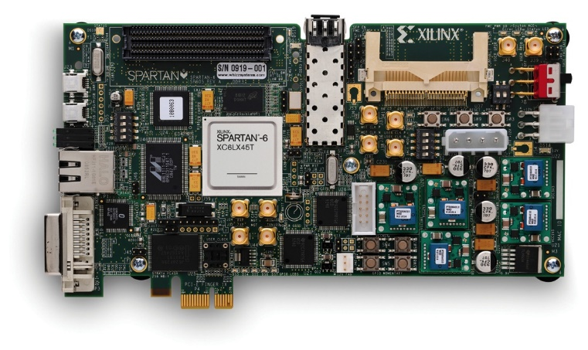
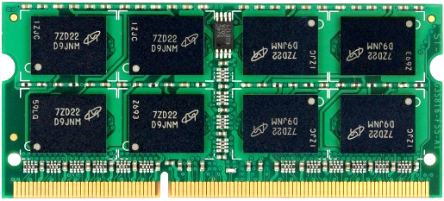
Experimental Methodology
Custom FPGA-based infrastructure
PCIe
DDR3
PC
FPGA
DIMM
C++ programs to specify commands
Generate
command sequence
Tested more than hundred chips from
three different manufacturers

Slide 35
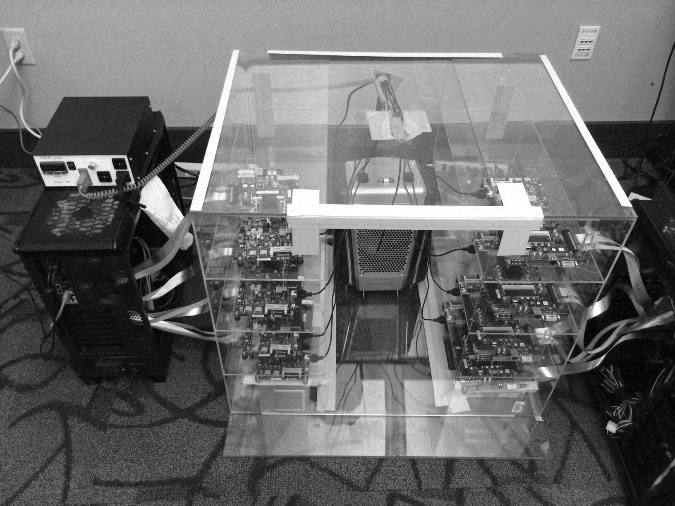
DRAM Testing Infrastructure
Temperature
Controller
FPGAs
Heater
FPGAs
PC
Notes:
This is the photo of our infrastructure, that we built mostly from scratch.
For higher throughput, we employ eight FPGAs, all of which are enclosed in thermally-regulated environment.

Slide 36
DETECT FAILURES WITH TESTING
Write some pattern
in the module
1
Repeat
3
2
Read
and verify
Wait until
refresh interval
Test with different data patterns

Slide 37
DETECTING DATA-DEPENDENT FAILURES
Even after hundreds of rounds,
a small number of new cells keep failing
Conclusion: Tests with many rounds of random patterns
cannot detect all failures

Slide 38
DETECTING DATA-DEPENDENT FAILURES
Even after hundreds of rounds,
a small number of new cells keep failing
Wait for it!!!
Negative Result???
Conclusion: Tests with many rounds of random patterns
cannot detect all failures

Slide 39
WHY NOT USE ECC?
No testing, use strong ECC
But amortize cost of ECC over larger data chunk
5EC6ED
Can potentially tolerate errors
at the cost of higher strength ECC
Notes:
ECC needs t*ceil(log(k+ 1)) bits to correct t -bit errors in a k -bit input data
and one more bit to detect t + 1 bit errors.
8B SECDED: 7 + 1 bits 12.5% overhead
1KB SECDED: 13+1 bits
8B 5EC6ED: 35 + 1 bits 56% overhead
1KB 5EC6ED: 65 + 1 bits 6.4% overhead

Slide 40
DETECTING DATA-DEPENDENT FAILURES
After starting with 4EC5ED, can reduce to 3EC4ED code after 2 rounds of tests
10 years

Slide 41
DETECTING DATA-DEPENDENT FAILURES
Can reduce to DECTED code after
around 10 rounds of tests
10 years

Slide 42
DETECTING DATA-DEPENDENT FAILURES
Can reduce to SECDED code after
7000 rounds of tests (4 hours)
10 years
Conclusion: Testing can help to reduce the ECC strength, but blocks memory for hours

Slide 43
DETECTING DATA-DEPENDENT FAILURES
Can reduce to SECDED code after
7000 rounds of tests (4 hours)
Wait for it!!!
Negative Result???
10 years
Conclusion: Testing can help to reduce the ECC strength, but blocks memory for hours

Slide 44
CONCLUSIONS SO FAR
Key Observations:
Testing alone cannot detect all possible failures
Combination of ECC and other mitigation techniques is much more effective
Testing can help to reduce the ECC strength
Even when starting with a higher strength ECC
But degrades performance

Slide 45


AN ONLINE PROFILING SYSTEM
Initially Protect DRAM
with Strong ECC
Periodically Test
Parts of DRAM
2
1
Test
ECC
Test
Test
Mitigate errors and
reduce ECC
3
Run tests periodically after a short interval
at smaller regions of memory

Slide 46
LED TO MULTIPLE WORKS ON HOW TO BUILD SUCH A SYSTEM
CHALLENGE:
Data-Dependent Failures
Efficacy of Detecting
Data-Dependent Failure
DRAM
MAKE DRAM SCALABLE
SIGMETRICS’14
MEMCON: DRAM-Internal
Independent Detection
System-Level Detection and Mitigation of Failures
SIGMETRICS’14
CAL’16, MICRO’17
PARBOR: Reverse Engineering Address Mapping
DSN’16

Slide 47
THE SECRET LIFE OF NEGATIVE RESULTS
NEW TECHNOLOGIES
MEMORY
DRAM SCALING IS ENDING
SCIENTIFIC REVOLUTION
CORES & MEMORY
Negative Results
In Scientific Revolution
Can we make DRAM Scalable?
CURRENT TIME
Close to a Scientific Revolution
CONCLUSION

Slide 48
THE STRUCTURE OF SCIENTIFIC REVOLUTIONS
Pre-paradigm
0
Scientific Revolution
4
Normal Science
1
Crisis and
Emergence of Scientific Theory
3
Anomaly
2
In order to be a part of a revolution,
we need to be born at a certain time

Slide 49
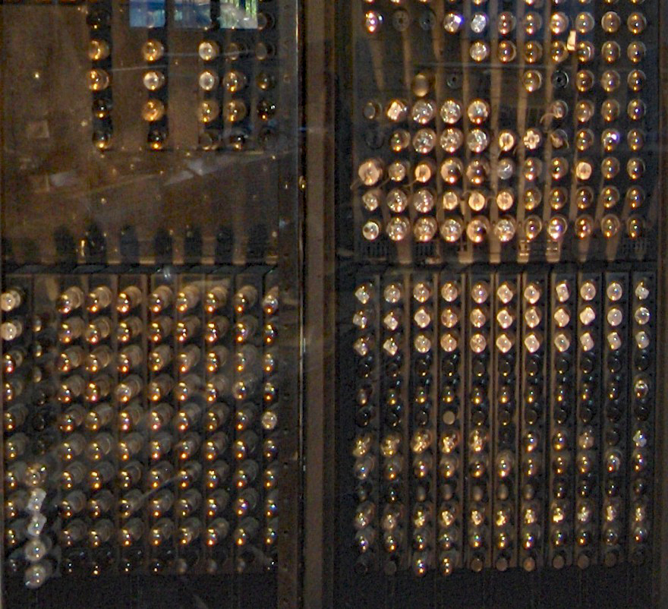
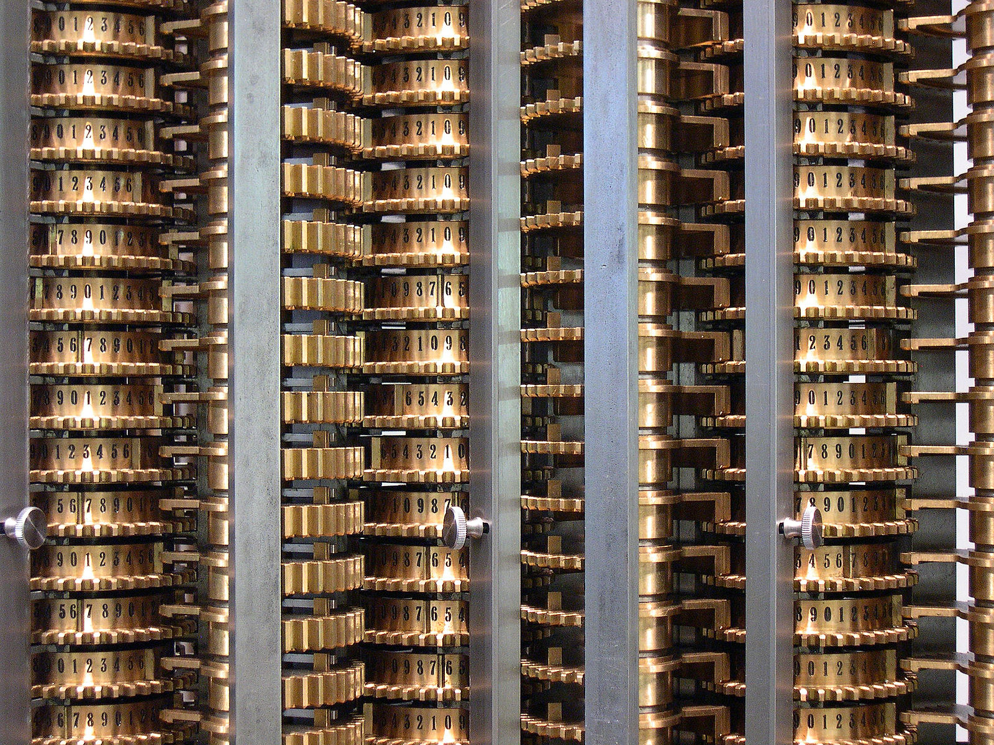
THE STRUCTURE OF SCIENTIFIC REVOLUTIONS
Pre-paradigm
0
Scientific Revolution
4
Abstract Models,
Different Technologies
(Babbage’s Mechanical Machine, Vacuum Tubes)
Normal Science
1
Crisis and
Emergence of Scientific Theory
3
ENIAC 1946
(Vacuum Tubes)
Difference Engine 1859
(Mechanical)
Anomaly
2
History of Computer Technology

Slide 50
THE STRUCTURE OF SCIENTIFIC REVOLUTIONS
Pre-paradigm
Babbage’s Mechanical Machine, Vacuum Tubes
0
Scientific Revolution
4
Normal Science
1
Crisis and
Emergence of Scientific Theory
3
Von-neumann Model,
CMOS Technology
Anomaly
2
Rules are established
Enter “Puzzle Solving”
History of Computer Technology

Slide 51
THE STRUCTURE OF SCIENTIFIC REVOLUTIONS
Pre-paradigm
Babbage’s Mechanical Machine, Vacuum Tubes
0
Scientific Revolution
4
Transistor Scaling is Ending
DRAM Scaling is Ending
Normal Science
Von-neumann Model,
CMOS Technology
1
Crisis and
Emergence of Scientific Theory
3
Anomaly
2
History of Computer Technology

Slide 52
THE STRUCTURE OF SCIENTIFIC REVOLUTIONS
Pre-paradigm
Babbage’s Mechanical Machine, Vacuum Tubes
Willing to Try Anything!!!
Non-Von-neumann models, Data-centric computing,
Quantum Computing, Resistive non-volatile memories
0
Scientific Revolution
4
Normal Science
Von-neumann Model,
CMOS Technology
1
Crisis and
Emergence of Scientific Theory
3
Anomaly
Transistor Scaling is Ending
DRAM Scaling is Ending
2
History of Computer Technology

Slide 53
THE STRUCTURE OF SCIENTIFIC REVOLUTIONS
Eventually, we will have a new model and technology
Pre-paradigm
Babbage’s Mechanical Machine, Vacuum Tubes
0
Scientific Revolution
???
4
Normal Science
Von-neumann Model,
CMOS Technology
1
Crisis and
Emergence of Scientific Theory
Many competing models and technologies
3
Anomaly
Transistor Scaling is Ending
DRAM Scaling is Ending
2
We are lucky to have the opportunity
to contribute to the next revolution!!!
History of Computer Technology

Slide 54
CONCLUSION
Next time you get a negative result, be happy!!!
Negative results are essential for initiating a revolution

Slide 55
THE SECRET LIFE OF NEGATIVE RESULTS
Samira Khan

